Slide 1


Yuhe Zhang
06/21/2023

Slide 2

Outline
Executive Summary
Introduction
Methodology
Results
Conclusion
Appendix

Slide 3
Executive Summary
Summary of Methodologies
Data Collection: SpaceX API, Webscraping from SpaceX Wikipedia
Data Wrangling: Missing Values Replaced by Mean Values for Payload Mass
Exploratory Data Analysis:
Analyzing Landing Outcomes by Orbit Types, Payload Mass, Booster Versions with SQL
Visually Analyzing Landing Outcomes with Charts by Orbit Types, Payload Mass, Launch Sites, Booster Versions
Interactive Plotly Dashboard: Analysis by Launch Sites, Payload Mass, Booster Versions
Predictive Analysis with Machine Learning: Logistic Regression, SVM, Decision Tree, KNN
Summary of All Results
Launch Success Rate Increases Over Time
Higher Success Rate for Higher Orbits and Lower Payload Mass
Higher Success Rate for Kennedy Space Center and Recent Launches at Cape Canaveral
Low Success Rate for Booster Versions V1.0, V1.1 and High for FT, B4, B5

Slide 4
Introduction
Project background and context
SpaceX advertises Falcon 9 rocket launches on its website with a cost of 62 million dollars
Other providers cost upward of 165 million dollars each
Much of the savings is because SpaceX can reuse the first stage
Problems we want to find answers
If we can determine if the first stage will land, we can determine the cost of a launch
This information can be used if an alternate company wants to bid against SpaceX for a rocket launch.

Slide 5

Section 1

Slide 6
Methodology
Data collection methodology
SpaceX API and Webscraping from SpaceX Wikipedia
Perform data wrangling
Missing Values Replaced by Mean Values for Payload Mass
Perform exploratory data analysis (EDA) using visualization and SQL
Analyzing Landing Outcomes by Orbit Types, Payload Mass, Booster Versions with SQL
Visually Analyzing Landing Outcomes with Charts by Orbit Types, Payload Mass, Launch Sites, Booster Versions
Perform interactive visual analytics using Folium and Plotly Dash
Visual Analysis by Launch Sites with Folium Maps
Visual Analysis by Launch Sites, Payload Mass, Booster Versions with Plotly Dash
Perform predictive analysis using classification models
Logistic Regression, SVM, Decision Tree, KNN
Parameter Tuning with GridSearch

Slide 7
Data Collection
SpaceX API
RESTful Interface
Get Core Data
Get Launch Site Data
Get Booster Version
Get Payload Data
Webscraping from SpaceX Wikipedia Page
HTML Requests
Python BeautifulSoup Package
Extract column names from HTML table header

Slide 8
Data Collection – SpaceX API
Data Collection - API
Send Get Request to SpaceX API Website
Extract Core Data, Launch Site Data, Payload Data, Booster Versions
Filter for Falcon 9 Data
Parse Data into Pandas Dataframe

Slide 9
Data Collection – Webscraping
Data Collection - Webscraping
Send HTTP Request to SpaceX Wikipedia Website
Extract Relevant Data with find_all Method
Store Data into Pandas Dataframe for Further Use
Parse Data into Pandas Dataframe with BeautifulSoup

Slide 10
Data Wrangling
Data Wrangling
Replace missing values for Payload Mass data with mean values
Create a landing outcome column "Class" for the dataframe

Slide 11
EDA with Data Visualization
EDA with Visualization
Charts
Flight Number vs. Launch Site: Success rate of each launch site over time
Payload Mass vs. Launch Site: Success rate of increase in payload mass over time
Orbit Type vs. Success Rate: Success rate of each orbit type
Flight Number vs. Orbit Type: Success rate with the development of orbit types over time
Payload Mass vs. Orbit Types: Success rate of each orbit type with different payload mass
Launch Success Yearly Trend: Success rate development over time

Slide 12
EDA with SQL
EDA with SQL
SQL Queries
Display the names of the unique launch sites in the space mission
Display 5 records where launch sites begin with the string 'CCA'
Display the total payload mass carried by boosters launched by NASA (CRS)
Display average payload mass carried by booster version F9 v1.1
List the date when the first successful landing outcome in ground pad was achieved.
List the names of the boosters which have success in drone ship and have payload mass greater than 4000 but less than 6000
List the total number of successful and failure mission outcomes
List the names of the booster versions which have carried the maximum payload mass
List the records which will display the month names, failure landing outcomes in drone ship, booster versions, launch site for the months in year 2015
Rank the count of successful landing outcomes between the date 04-06-2010 and 20-03-2017 in descending order

Slide 13
Build an Interactive Map with Folium
Launch Site Locations Analysis with Folium
Map Objects
Edged circles with radius = 1000: Space launch sites
Markers: Labeling all objects
Marker Cluster: Creating a bunch of markers around space launch sites to indicate success (green) or failure (red) of Falcon 9 first stage landing
Lines: Measuring the distance between the launch site and the next coastline or city.

Slide 14
Build a Dashboard with Plotly Dash
Interactive Plotly Dashboard
Input Elements
Dropdown list for the launch sites
Range Slider: Selecting the payload mass
Output Elements
Pie Chart: Showing the success rate of each launch site
Scatterplot: Showing the landing outcomes by payload mass and booster versions

Slide 15
Predictive Analysis (Classification)
Machine Learning Prediction
Preprocessing
One-Hot-Encoding for categorical features
Standardize data with StandardScaler
Split data into independent/dependent variables and training and testing set
Model Building
Logistic Regression, SVM, Decision Tree, KNN
Optimization
Optimizing the models based on their hyperparameters using GridSearch
Evaluation
Select the best tuned hyperparameters
Use Score and Accuracy to compare among models
Display confusion matrix to illustrate and compare the precision and recall of each model

Slide 16
Predictive Analysis (Classification)
Feature engineering for categorical features
Standardize data with StandardScaler
Build Models (Logistic Regression, SVM, Decision Tree, KNN)
Optimize hyperparameters with GridSearch
Split data into training and testing set
Calculate and compare model accuracy and score
Display confusion matrix to illustrate and compare model precision and recall

Slide 17
Results
Exploratory data analysis results
Launch success rate increases over time
Higher success rate for higher orbits
Interactive analytics demo in screenshots
Higher success rate for lower payload mass
Higher success rate for Kennedy Space Center and recent launches at Cape Canaveral
Low Success Rate for Booster Versions V1.0, V1.1 and High for FT, B4, B5
Predictive analysis results
Best prediction by Decision Tree model

Slide 18

Section 2

Slide 19
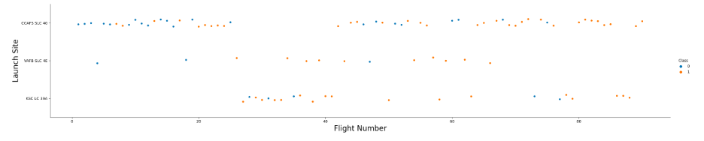
Flight Number vs. Launch Site

Slide 20
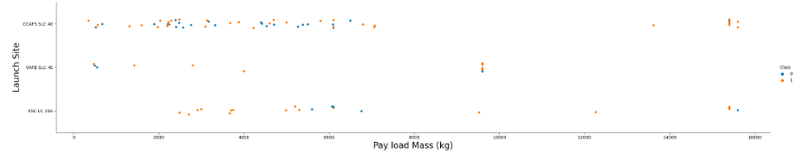
Payload vs. Launch Site

Slide 21
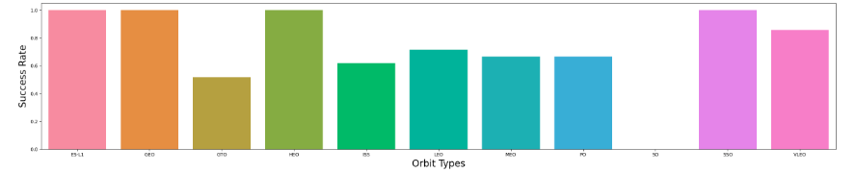
Success Rate vs. Orbit Type
High Orbits: ES-L1, GEO, HEO, SSO
Low Orbits: GTO, ISS, LEO, MEO, PO, VLEO

Slide 22
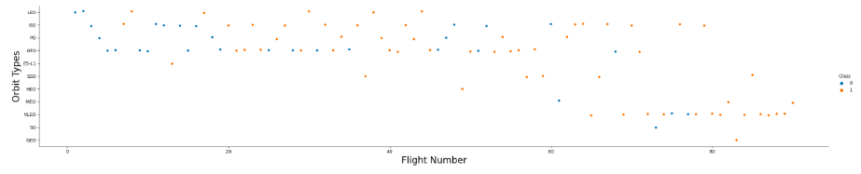
Flight Number vs. Orbit Type

Slide 23
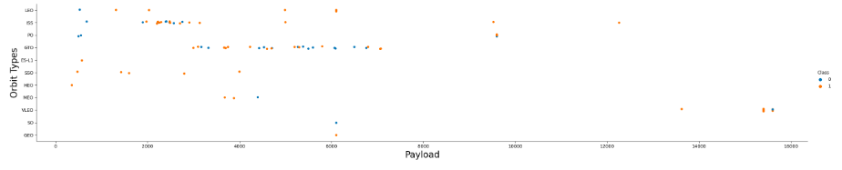
Payload vs. Orbit Type

Slide 24
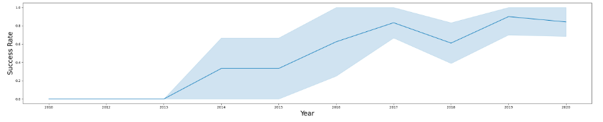
Launch Success Yearly Trend

Slide 25
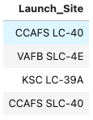
All Launch Site Names
CCAFS: Cape Canaveral Air Force Station
VAFB: Vandenburg Air Force Base
KSC: Kennedy Space Center

Slide 26
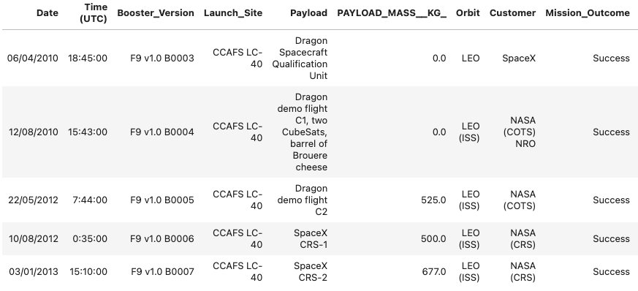
Launch Site Names Begin with 'CCA'

Slide 27
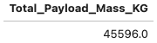
Total Payload Mass
Total payload mass carried by boosters launched by NASA (CRS)

Slide 28
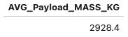
Average Payload Mass by F9 V1.1
Average payload mass carried by booster version F9 V1.1

Slide 29
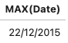
First Successful Ground Landing Date
Date of the first successful landing outcome in ground pad was achieved

Slide 30
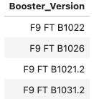
Successful Drone Ship Landing with Payload between 4000 and 6000
Names of boosters which have successfully landed on drone ship and had payload mass greater than 4000 but less than 6000

Slide 31
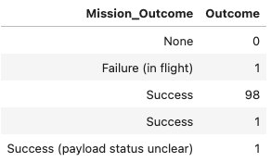
Total Number of Successful and Failure Mission Outcomes
Total number of successful and failure mission outcomes

Slide 32
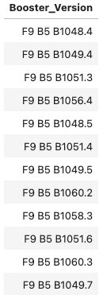
Boosters Carried Maximum Payload
Names of the booster which have carried the maximum payload mass

Slide 33
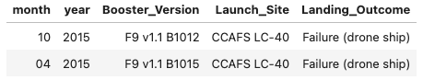
2015 Launch Records
Records of the failed landing outcomes in drone ship, their booster versions, and launch site names in 2015

Slide 34
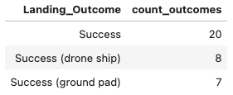
Rank Landing Outcomes Between 2010-06-04 and 2017-03-20
Ranking the count of successful landing outcomes between the date 2010-06-04 and 2017-03-20 in descending order

Slide 35

Section 3

Slide 36
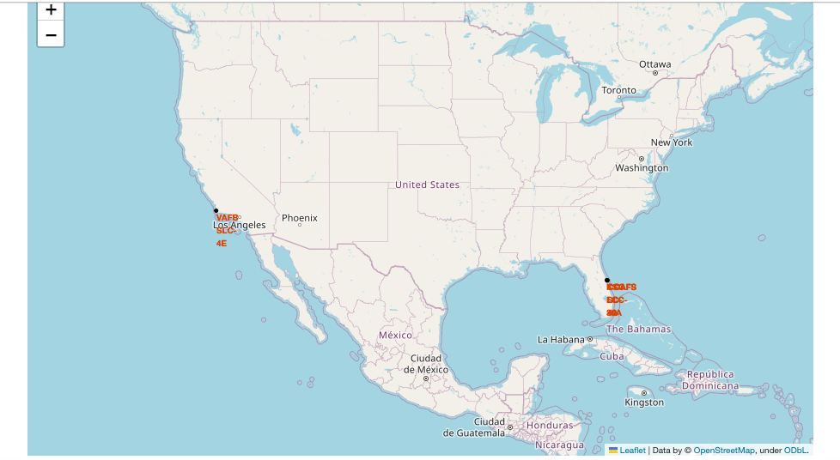
All Launch Site Locations
VAFB Location: California Coast
KSC Location: Florida Coast
CCAFS Location: Florida Coast

Slide 37
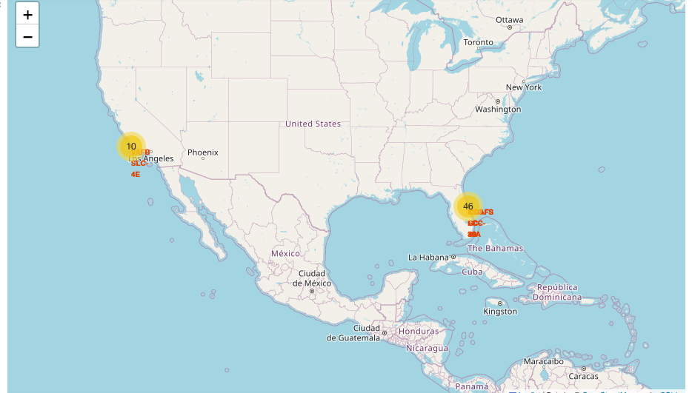
Success vs. Failed Launches For each Site on a Map

Slide 38
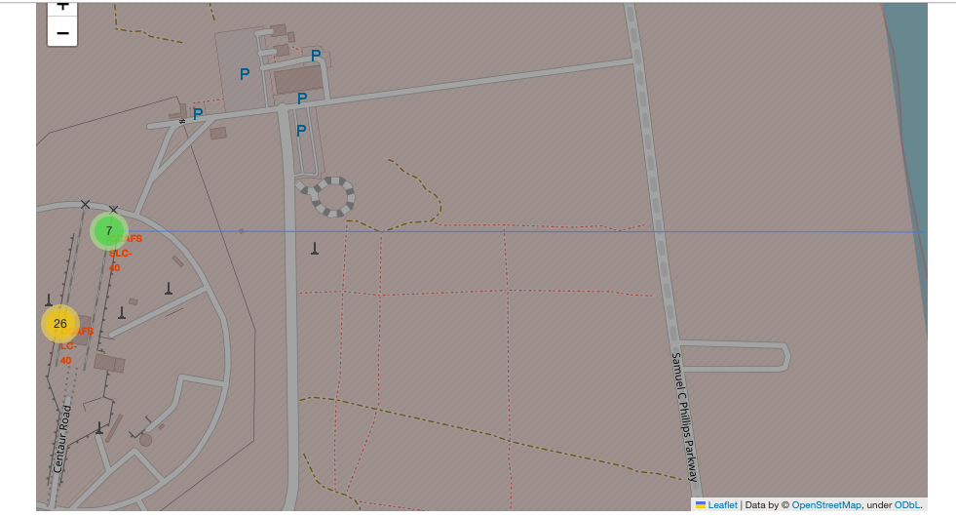
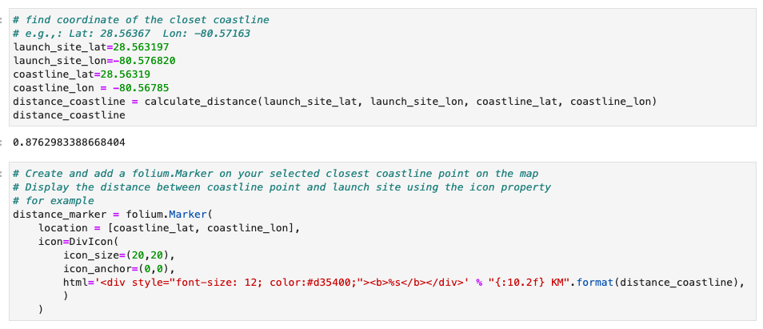
CCAFS Location Distance to Florida Coast

Slide 39

Section 4

Slide 40
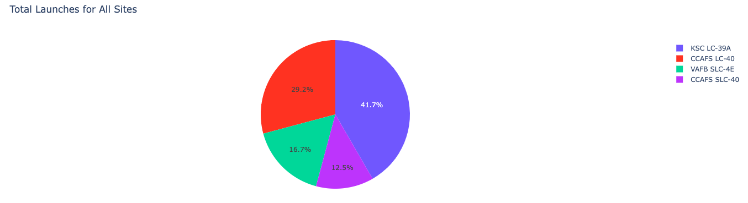
Success Percentage Composition by Each Launch Site
KSC LC-39A has the highest success percentage of 41.7% among all launch sites

Slide 41
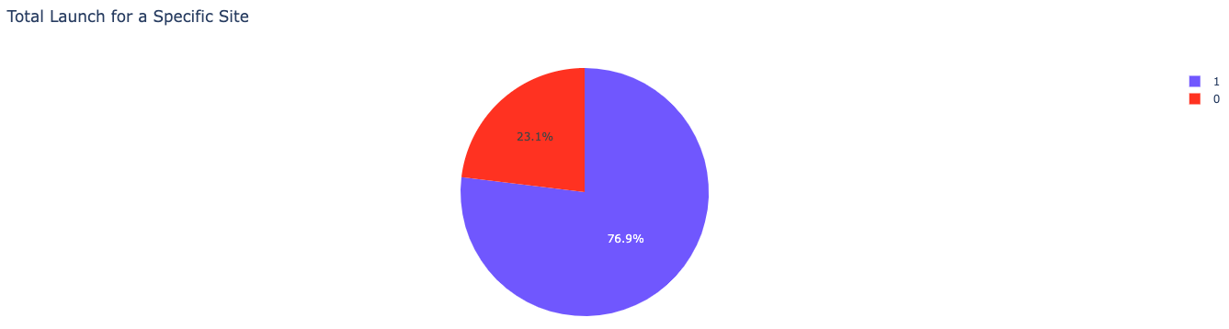
KSC LC-39A Success Rate
KSC LC-39A achieved a success rate of 76.9% and a failure rate of 23.1% for its launches

Slide 42
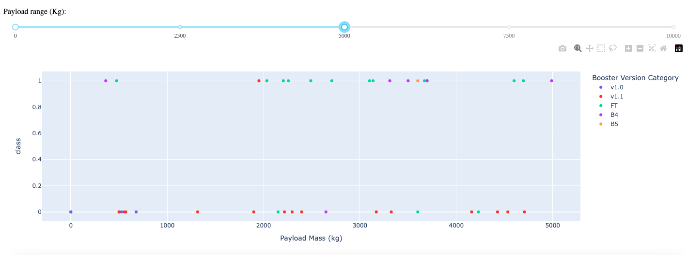
Payload Mass vs Launch Outcome for All Sites: 0 – 5000kg Range
Higher success rate for lower payload mass
Low success rate for Booster Versions V1.0, V1.1 and higher for FT, B4, B5

Slide 43
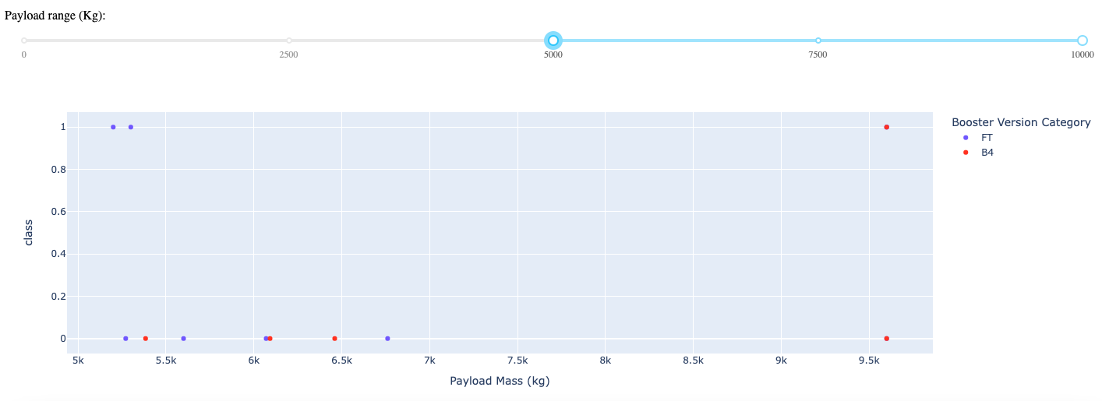
Payload Mass vs Launch Outcome for All Sites: 5000 – 10000kg Range
Lower success rate for higher payload mass
Low success rate for Booster Versions V1.0, V1.1 and higher for FT, B4, B5

Slide 44

Section 5

Slide 45
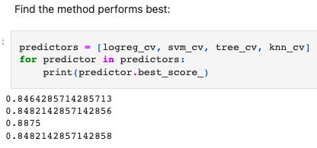
Classification Accuracy
The Decision Tree model has the highest accuracy of 88.75% across 4 models

Slide 46
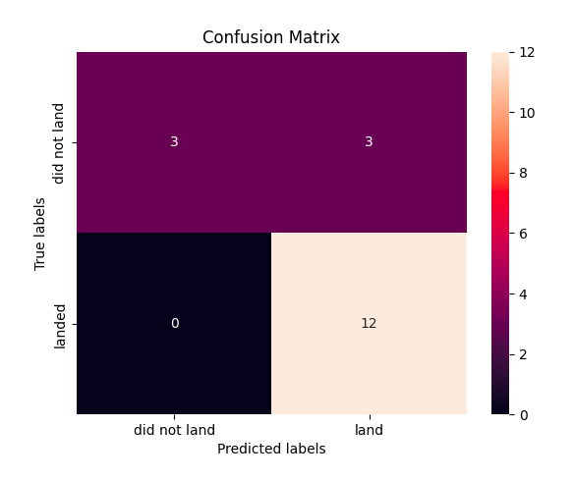
Confusion Matrix
The decision tree model shows high precision in the way it can distinguish between the different classes. The major problem lie in the low recall rate in terms of false positives. In other words, the model falsely predicts unsuccessful landing as successful landing for 50% of the testing set.

Slide 47
Conclusions
Success rate increases with flight number increase at each launch site
Launch success rate started to increase in 2013 till 2020.
Higher orbits such as ES-L1, GEO, HEO, SSO have the most success rate.
KSC LC-39A had the most successful launches of any sites.
The Decision tree classifier is the best machine learning algorithm for this task.

Slide 48


